Slide 1
Flow Characterization for Jet Transition Piece in TFCL
Collin Greene
Advisor: Dr. Jesse Little
University of Arizona, Aerospace and Mechanical Engineering

Slide 2
Introduction and Goals
Project Objectives:
To characterize flow from jet outlet once circle-to-square transition piece is installed
To detect any underlying distortions caused by transition piece
Why are we interested?

Slide 3
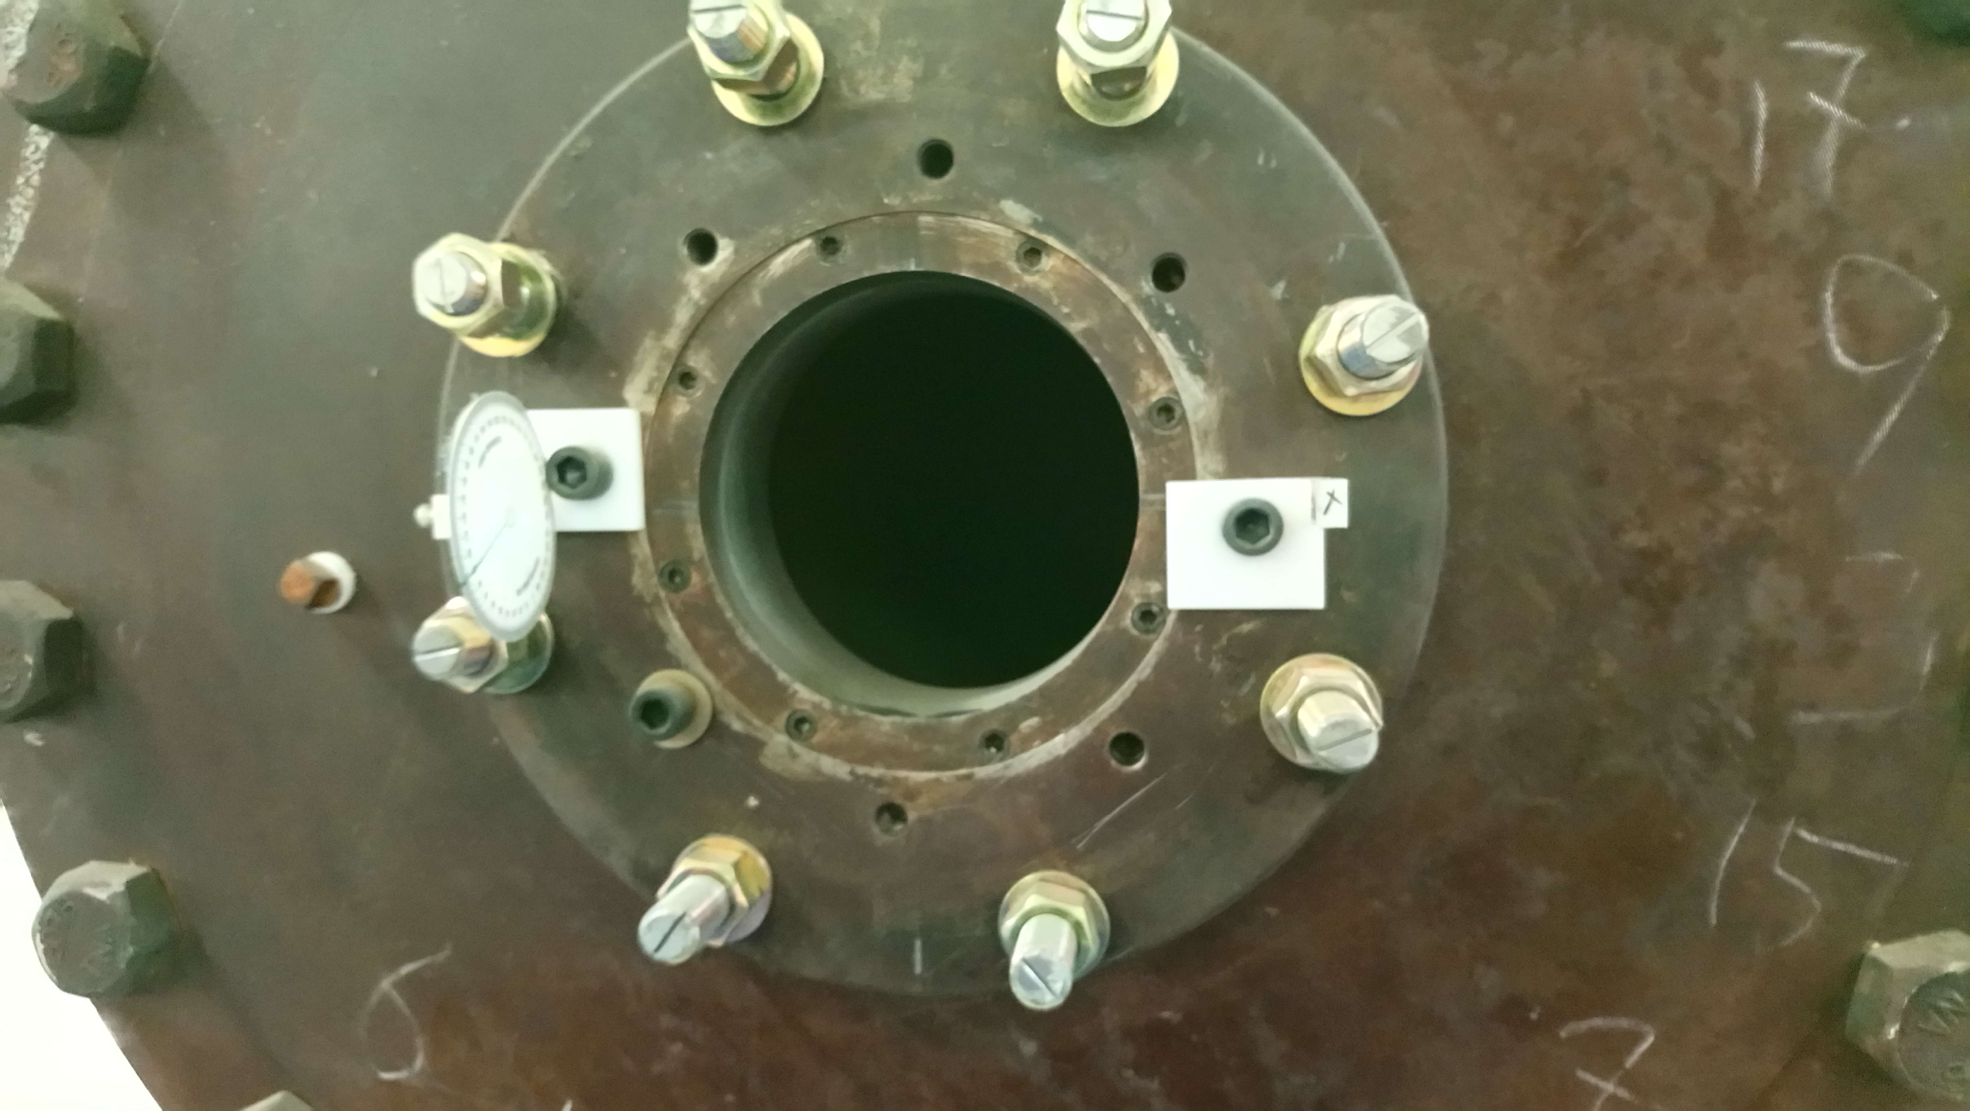
Jet Facility
Located at University of Arizona AME Building
Active Flow Control
Current configuration produces compressible subsonic air flow up to Mach 0.6
Needs transition piece to install test section and increase flow velocity for future experiments
Top: Image of current jet exit
Bottom: Test section example https://mems.duke.edu/research/centers-labs/wind-tunnel
Notes:
Will describe what a test section is used for and emphasize that the photo here is just an example for the audience’s visualization
AS: If you are presenting this in front of an audience you want to increase the figure caption size and point things out on the figure

Slide 4
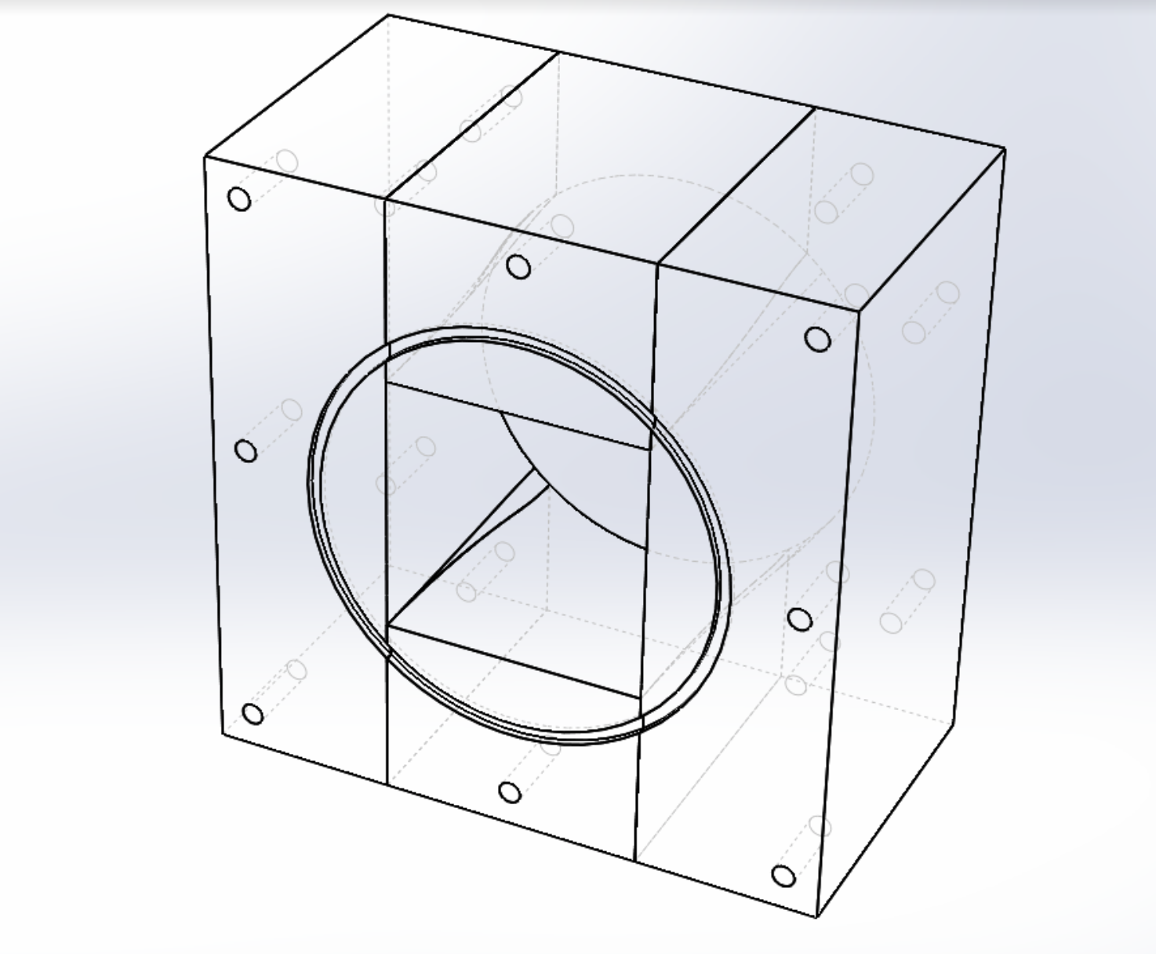
Transition Piece
Reduces flow area from circular cross section to square cross section
Creates higher speed flow at outlet
Preliminary calculations show that transition piece increases exit flow speed from Mach [0.1 0.3] to [0.2 0.94]
Image of transition piece. Circular region is where piece will be attached to jet outlet, square region is outlet of piece where flow will exit for future experiments.

Slide 5
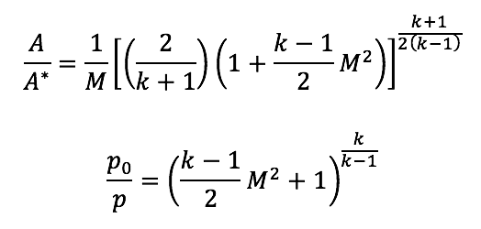
Preliminary Calculations
Isentropic Flow Equations:
Through analysis we can find theoretical outlet Mach numbers and differential pressure values for transition piece
Notes:
Will describe how previous data was used to find constants for the transition piece calculations
AS: I changed the second bullet point

Slide 6
Preliminary Calculations
Notes:
Will discuss meaning of results during presentation
AS: You should increase the font and tick label sizes. You want figures with a white outline - it looks better

Slide 7
Preliminary Calculations
Notes:
I am trying to decide how I can describe this slide to the audience in a simplistic, understandable manner. If you have suggestions, they would be helpful!
AS: same thing here

Slide 8
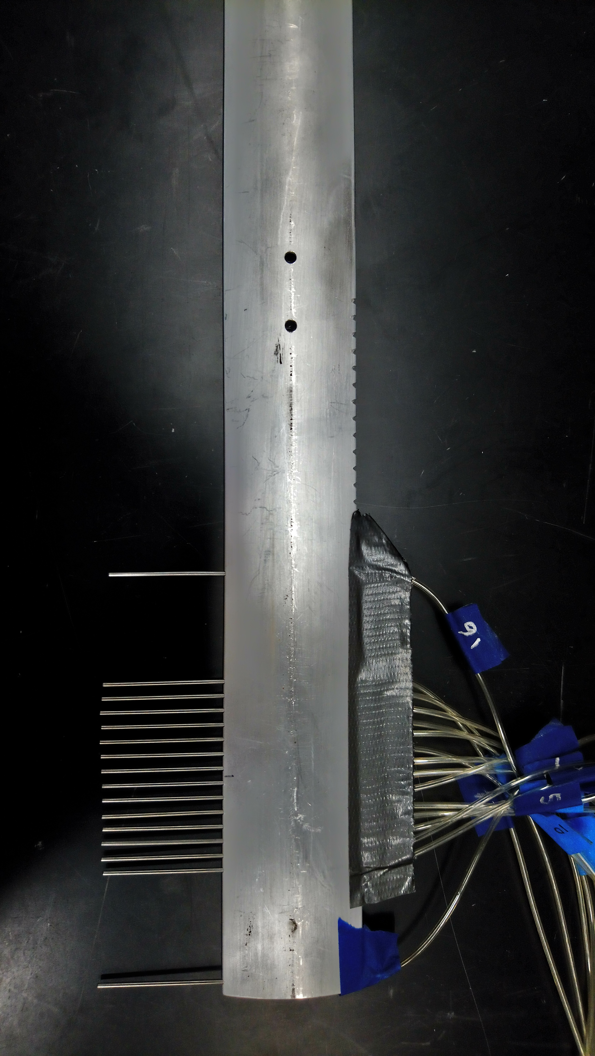
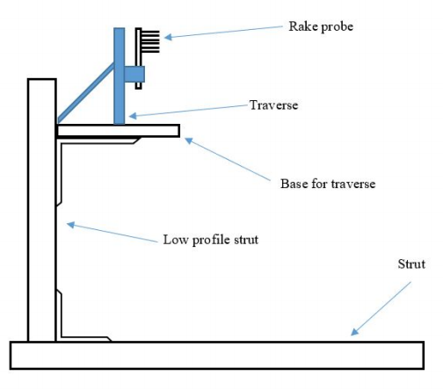
Data Acquisition Method
Total pressure rake will measure pressure values for locations downstream of the transition piece outlet
‘Wake rake’ uses pitot tubes to collect pressure data
Data will be collected using LabView and analyzed using MATLAB to find mean flow velocities
Flow Direction
Top: Image of total pressure rake used to collect data
Bottom: Diagram of total pressure rake configuration. Transition piece exit will be to right of diagram (Ashish Singh, Ns-DBD Wake Experiment Planning Notes)
Notes:
Is this correct citation?
AS: make figures larger

Slide 9
Next Steps
Collect pressure data for multiple transition piece exit locations and Mach numbers
Convert pressure values to create velocity profile for flow from transition piece
Assess potential discrepancies between experimental data and theoretical calculations
Notes:
AS: You can add a note as to they type of experiments you do – active flow control

Slide 10
Acknowledgements & References
Thank you!
Arizona Space Grant
Dr. Jesse Little
Ashish Singh
References:
[1] https://mems.duke.edu/research/centers-labs/wind-tunnel
[2] https://www.grc.nasa.gov/www/k-12/airplane/isentrop.html
[3] Ashish Singh, Ns-DBD Wake Experiment Planning Notes

Slide 11
Questions?
Notes:
AS: if you used any references cite them here

